Slide 1

Project Report Employee Management System(EMS)
Anas Munir cs211104
Arhum Hussain cs211112
Muneeb Qureshi cs211271
Wali Hussain cs211122

Slide 2
Abstract:
The Employee Management System is a comprehensive software solution designed to streamline and automate various aspects of employee management within an organization. This report presents an in-depth analysis of the development, implementation, and functionality of the Employee Management System.
The primary objective of the system is to provide a centralized platform that enables efficient management of employee data, simplifies administrative tasks, and enhances communication between employees and management. The system incorporates modules for employee information management, attendance tracking, leave management, performance evaluation, and payroll processing.
Through the utilization of modern technologies and database management systems, the Employee Management System offers a user-friendly interface for administrators, supervisors, and employees to access and manage their respective functionalities. The system aims to enhance organizational efficiency, reduce manual paperwork, minimize errors, and facilitate effective decision-making processes.
This report highlights the key features and modules of the Employee Management System, including user authentication, data security, data visualization, and reporting capabilities. It further discusses the software development lifecycle, implementation strategies, and challenges encountered during the deployment process.
The findings of this report demonstrate the significant benefits and improvements achieved through the adoption of the Employee Management System, such as increased productivity, streamlined HR processes, enhanced employee satisfaction, and improved data accuracy. Additionally, recommendations for further system enhancements and future scalability are provided to support the system's continued success and adaptability in a dynamic organizational environment.
Overall, the Employee Management System serves as a valuable tool for organizations to effectively manage their workforce, optimize HR operations, and foster a productive and harmonious work environment.

Slide 3

Introduction:
The Employee Management System (EMS) is a software application designed to streamline employee management processes within an organization. The purpose of this project is to develop a robust and user-friendly system that allows efficient management of employee data, job departments, salaries, qualifications, leave requests, and payroll.

Slide 4

Methodology :
The EMS project followed an iterative and incremental development
approach using SQL Database for the back-end and Java Swing for the front-end user interface.
The database management system used was MySQL.
The project made use of object-oriented programming principles,
database design best practices, and modular code organization.

Slide 5

System Architecture:
The EMS system consists of two main components: the front-end user interface and the back-end database. The front-end was developed using Java Swing, which provides a visually appealing and interactive user interface. The back-end utilizes MySQL as the database management system to store and retrieve data.
The user interface interacts with the database through a data access layer, which handles the CRUD (Create, Read, Update, Delete) operations for each table. The back-end code communicates with the database using JDBC (Java Database Connectivity).

Slide 6
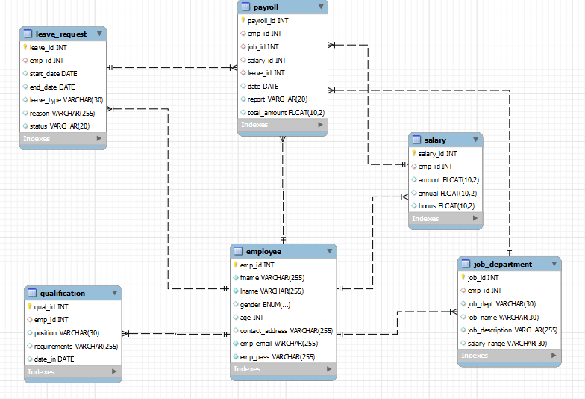
ERD:

Slide 7
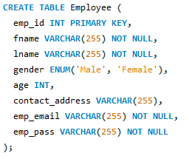
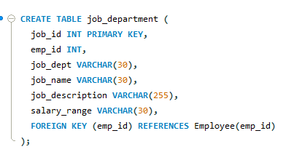
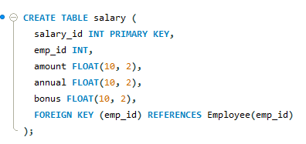
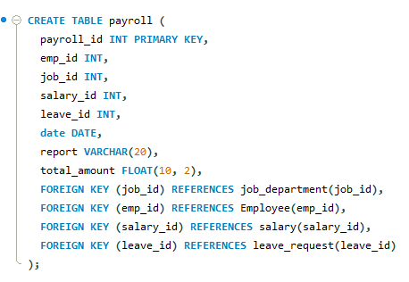
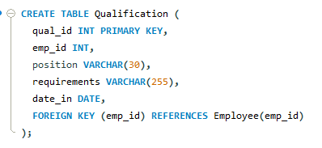
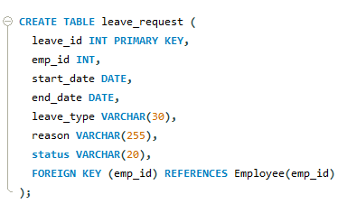
Functionality Overview: MySQL tables:

Slide 8
Employee Module:
The Employee module serves as the foundation of the system, managing all employee-related information. It includes features such as:
Employee profile management: Capture and store comprehensive employee details, including personal information, contact details, and employment history.
Document management: Store and manage essential documents like resumes, contracts, and certifications.
Reporting hierarchy: Define and maintain the organizational reporting structure and employee relationships.
Employee search: Efficiently search and retrieve employee records based on various criteria.
Employee self-service: Allow employees to update their personal information, request changes, and view relevant HR policies.
We have developed all type of CRUD(create, read, update, delete) operations of the employee.

Slide 9
Leave Module:
The Leave module focuses on managing employee leave requests, tracking balances, and ensuring proper leave management. Its key features include:
Leave application and approval: Employees can submit leave requests, and managers can review and approve them.
Leave types and policies: Define and configure different leave types (e.g., annual leave, sick leave) and associated policies.
Leave balance tracking: Track available leave balances, including accrued and used leave days.
Leave calendar: Maintain a centralized calendar to visualize employee leave schedules and avoid scheduling conflicts.
Leave reports and analytics: Generate reports on leave usage, trends, and patterns for monitoring and decision-making purposes.

Slide 10
Payroll Module:
The Payroll module automates the calculation and processing of employee salaries, tax deductions, and other related financial aspects. Its features include:
Salary calculation: Calculate salaries based on predefined salary structures, allowances, and deductions.
Payroll processing: Generate payslips and automate the distribution of salaries to employees.
Taxation and deductions: Manage tax deductions, insurance contributions, and other deductions as per legal requirements.
Salary revision and increments: Facilitate salary revisions and increments based on performance appraisals or organizational policies.
Compliance and reporting: Ensure compliance with tax regulations and generate reports for payroll auditing purposes.

Slide 11
Qualification Module:
The Qualification module tracks and manages employee qualifications, skills, certifications, and training records. Its features include:
Qualification tracking: Store and update employee educational qualifications, professional certifications, and licenses.
Skill management: Capture and track employee skills, competencies, and expertise.
Training management: Record employee training programs, track attendance, and monitor completion status.
Skill gap analysis: Identify skill gaps and training needs for employees and facilitate targeted development plans.
Certification reminders: Set reminders for certificate renewals and expirations.

Slide 12
Job Department Module:
The Job Department module focuses on managing job positions, departments, and organizational structure. Its features include:
Job position management: Define and maintain job positions, job descriptions, and associated responsibilities.
Department management: Create and manage organizational departments and hierarchies.
Role-based access control: Assign appropriate system access and permissions based on job roles.
Department transfers: Facilitate employee transfers between departments or job positions.
Organizational chart: Visualize the hierarchical structure of the organization.

Slide 13
Salary Module:
The Salary module handles salary-related processes and provides insights into compensation management. Its features include:
Salary structure management: Define and configure salary structures based on job positions, grades, or experience levels.
Bonus and incentive management: Manage variable components like bonuses, commissions, or performance-based incentives.
Salary revisions and history: Track salary revisions, historical salary data, and promotions.
Compensation analytics: Analyze salary data, trends, and distribution across the organization.
Salary benchmarking: Compare salaries with industry standards and market rates to ensure competitiveness.

Slide 14
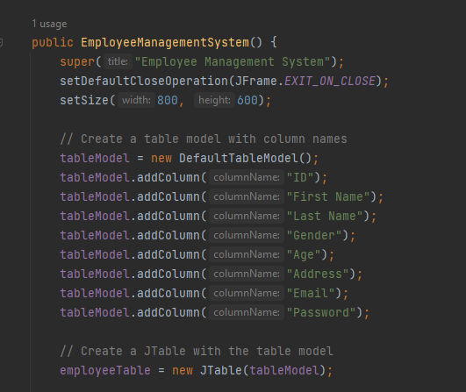
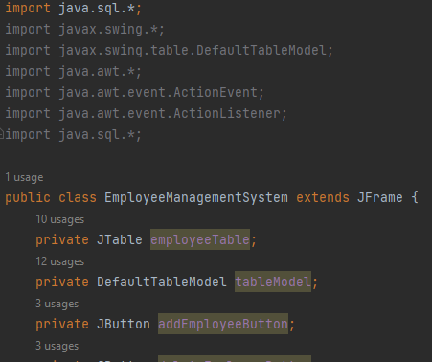
Table Functionalities in Java:

Slide 15
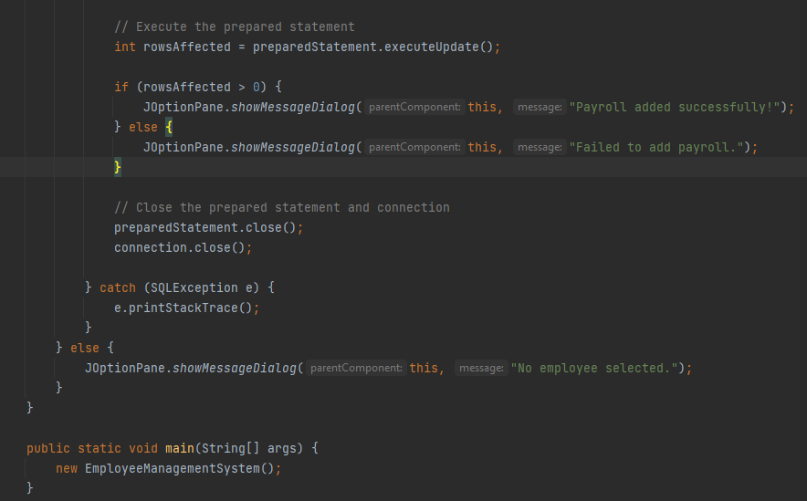

Slide 16
JPasswordField passwordField = new JPasswordField(); passwordField.setFont(new Font("Times New Roman", Font.PLAIN, 20)); passwordField.setBounds(450,250,420,50); ems.loginFrame.add(passwordField); JButton submitButton=new JButton("Submit"); submitButton.setFont(new Font("Times New Roman", Font.PLAIN, 30)); submitButton.setBounds(450,400,250, 50); submitButton.addActionListener(actionEvent -> { username = usernameField.getText(); password = String.valueOf(passwordField.getPassword()); try { boolean auth = ems.login(username, password); if(auth){ ems.loginFrame.dispose(); ems.mainMenu(); } } catch (SQLException throwables) { throwables.printStackTrace(); } }); ems.loginFrame.add(submitButton); ems.loginFrame.setSize(1100,750); ems.loginFrame.setLayout(null); ems.loginFrame.setVisible(true); ems.loginFrame.setDefaultCloseOperation(WindowConstants.EXIT_ON_CLOSE);

Slide 17
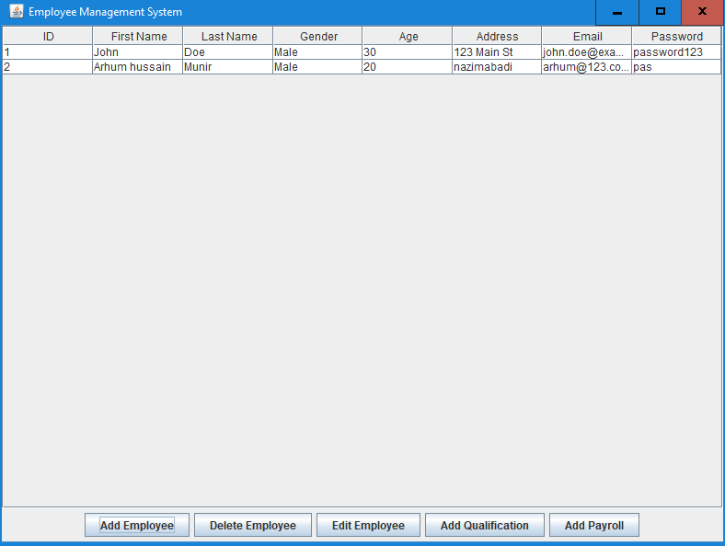
User Interface:
The EMS user interface provides a user-friendly and intuitive design to facilitate easy navigation and interaction. It includes forms, tables, and buttons to input and display data. Users can input employee details, manage job departments, view salary information, handle qualifications, process leave requests, and generate payroll reports.

Slide 18
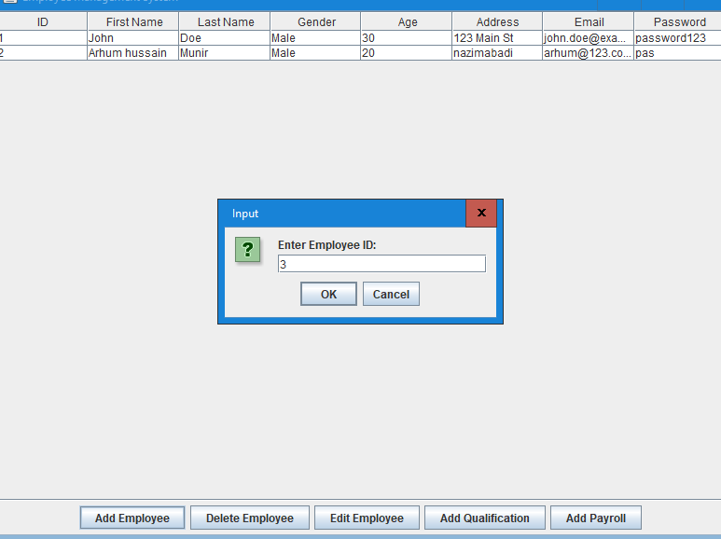
Testing and Quality Assurance:
The EMS project underwent thorough testing to ensure the functionality, reliability, and performance of the system. Unit tests were conducted to validate the individual components, while integration testing was performed to ensure proper communication between the front-end and back-end.
Various test cases were created to cover different scenarios, including valid and invalid inputs, edge cases, and error handling. The tests were executed to identify and resolve any bugs or issues. Quality assurance measures, such as code reviews and continuous integration, were implemented to maintain code quality and ensure adherence to best practices.

Slide 19
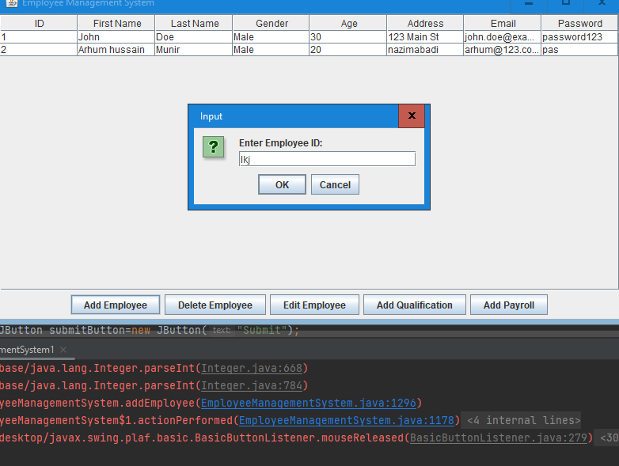
Datatype error:

Slide 20
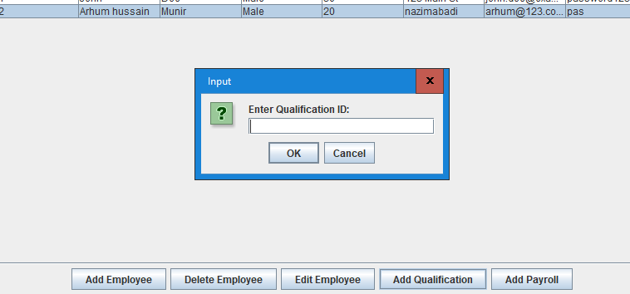
Functionalities of other tables:

Slide 21
Supported Operating System:
Windows:
This project can easily be configured on windows operating System. For running this project on windows you have to install java jdk, mysql workbench 8.0 CE and a jdbc driver.
Linux:
We can also run this project on all operating systems of linux.
Mac
We can also run this project on all operating systems of Mac OS.

Slide 22

Conclusion!
In conclusion, the development of the Employee Management System (EMS) has resulted in a comprehensive solution for efficient management of employee data, job departments, salaries, qualifications, leave requests, and payroll within an organization. The system offers a user-friendly interface, robust functionality, and adherence to industry-standard development practices. The EMS project demonstrates the successful application of Java, JavaSwing, MySQL, and good software engineering principles in developing a scalable and effective employee management system.

